Slide 1


Emre Nuray
June 26, 2022

Slide 2

Outline
Executive Summary
Introduction
Methodology
Results
Conclusion
Appendix

Slide 3
Executive Summary
Summary of methodologies
Data collection with API and web scrapping
Data wrangling
Exploratory data analysis with SQL
Exploratory data analysis with visualization
Building interactive map using Folium
Building a dashboard with Plotly Dash
Applying machine learning techniques
Summary of all results
Exploratory data analysis
Analysis with interactive map
Analysis of machine learning methods

Slide 4
Introduction
Project background and context
The commercial space age is here, companies are making space travel affordable for everyone. The most successful among these companies is undoubtedly SpaceX. Of course, the biggest reason behind this success is the cost for customer.
SpaceX advertises Falcon 9 rocket launches on its website, with a cost of 62 million dollars; other providers cost upward of 165 million dollars each, much of the savings is because SpaceX can reuse the first stage.
In this project, we will predict whether the first stage of Falcon 9 will land successfully. If we determine this correctly, we can also determine the cost of the launch.
Problems you want to find answers
Relation between each rocket data
Finding best successful landing rate

Slide 5

Section 1

Slide 6
Methodology
Executive Summary
Data collection methodology:
SpaceX API
Web scraping from Wikipedia page of Falcon 9
Perform data wrangling
Labelling outcomes respect to the boosters successful/fail landed data
Perform exploratory data analysis (EDA) using visualization and SQL
Perform interactive visual analytics using Folium and Plotly Dash
Perform predictive analysis using classification models
SVM, Classification Tress, Logistic Regression

Slide 7
Data Collection
Data collected in two steps; SpaceX API and web scraping from Wikipedia pages of Falcon 9 and Falcon Heavy Launches Records from Wikipedia
You need to present your data collection process use key phrases and flowcharts
SpaceX API
Web Scraping
1
Request data from API
2
API returns data in .JSON format
3
Normalize data into CSV format using Pandas library
1
Get HTML response from Wikipedia page
2
Extract data using Beautiful Soup library
3
Normalize data into CSV format using Pandas library

Slide 8
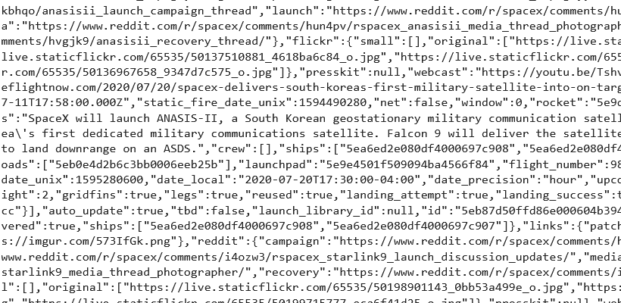
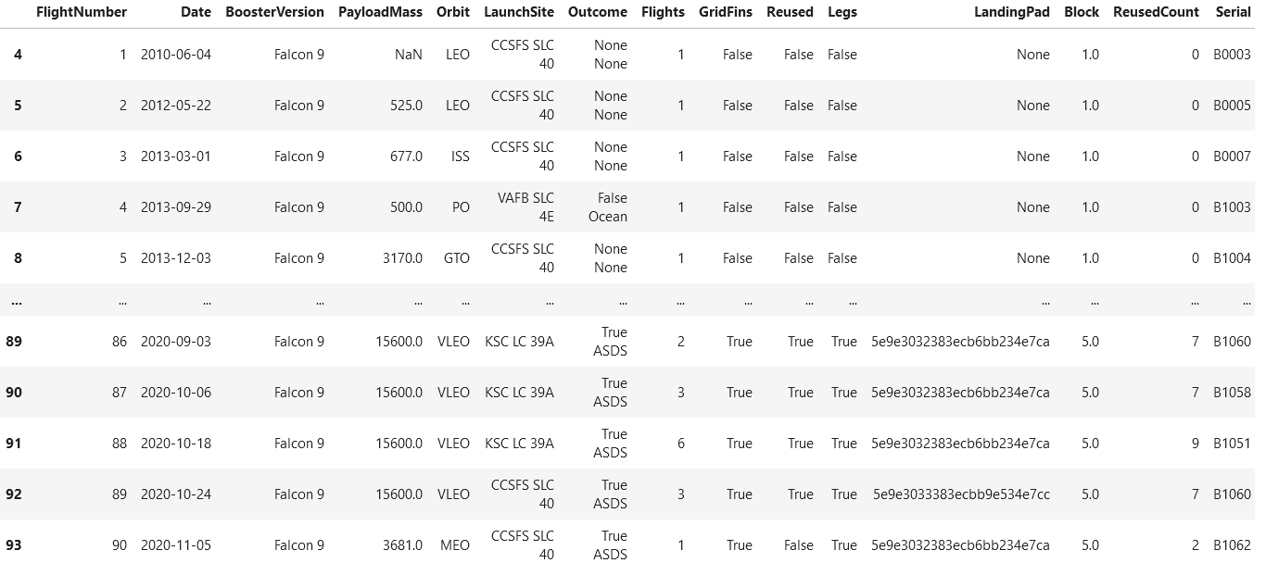
Data Collection – SpaceX API
Requesting rocket launch data from SpaceX API
Converting response to a JSON format with normalizing
Using custom functions to extract data properly
Combining the data into a dictionary
Creating data frame
Filtering data frame and exporting to the CSV file
Click to go GitHub

Slide 9
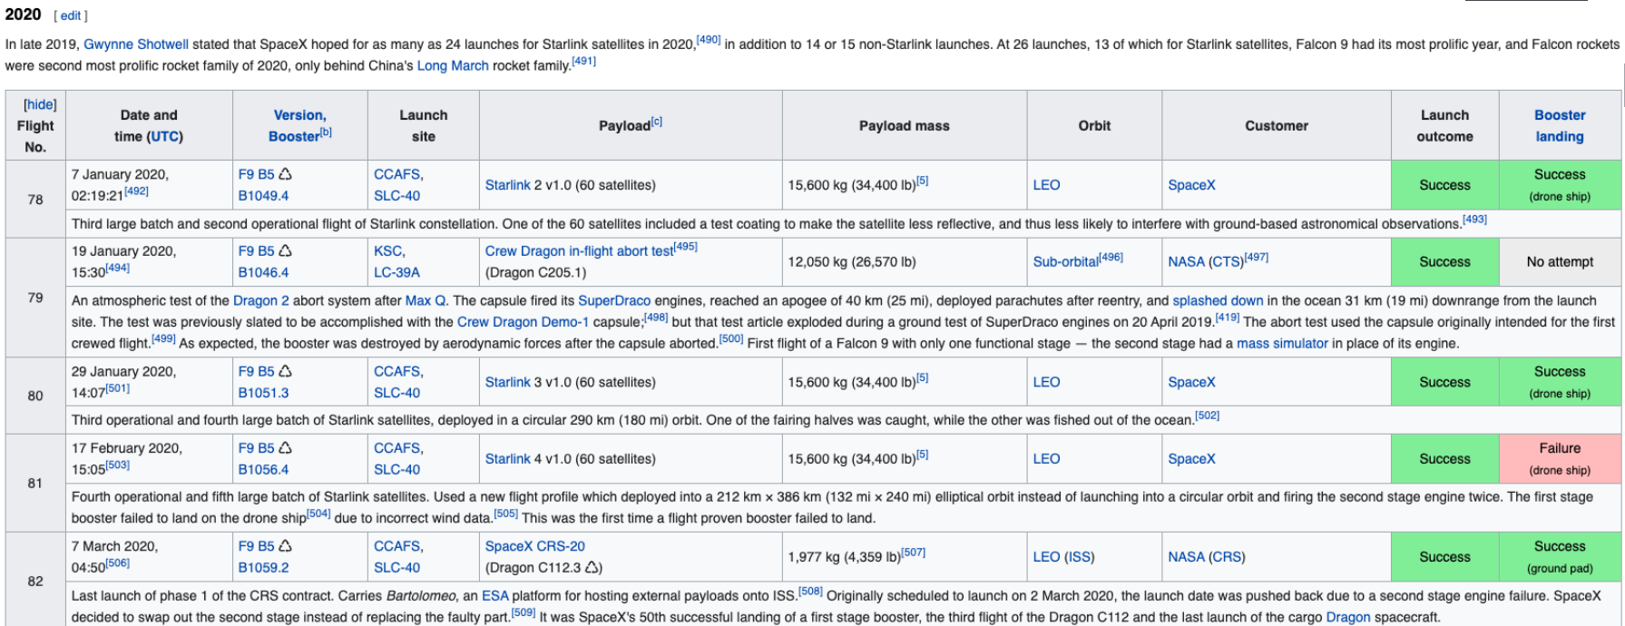
Data Collection - Scraping
Getting response from HTML
Creating a Beautiful Soup object
Finding all tables
Extracting column names
Creating an empty dictionary with keys
Filling up the dictionary with launch records
Creating data frame
Exporting results into the CSV
Click to go GitHub

Slide 10
Data Wrangling
Defining cases
True Ocean: the mission result has successfully landed in a specific area of the ocean
False Ocean: the mission result has not successfully landed in a specific area of the ocean
True RTLS: the mission result successfully landed on the ground pad
False RTLS: the mission result has not successfully landed on the ground pad
True ASDS: the mission result has successfully landed on the drone ship
False ASDS: the mission result has not landed on the drone ship
Labelling
0 → Failure
1 → Successful
Click to go GitHub

Slide 11
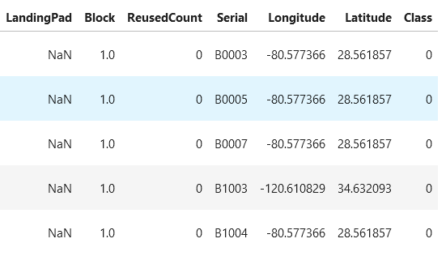
Data Wrangling
Calculating the number of launches at each site
Calculating the number and occurrence of each orbit
Calculating the number and occurrence of mission outcome per orbit type
Creating a landing outcome label
Calculating the success rate for every landing
Exporting dataset to a CSV
Click to go GitHub

Slide 12
EDA with Data Visualization
Flight Number vs Launch Site
Payload vs Launch Site
Flight Number vs Orbit Type
Payload vs Orbit Type
Data Visualization
Scatter Chart
Bar Chart
Line Chart
Purpose of charts is to show the relationship between the two axes.
Orbit Type vs Success Rate
Year vs Success Rate
Click to go GitHub

Slide 13
EDA with SQL
Executing SQL queries to answer following questions
Unique launch sites in the space mission
Launch sites begin with the string 'CCA’
Total payload mass carried by boosters CRS
Average payload mass carried by booster version v1.1
Date when the first successful landing outcome in ground pad was achieved
Names of the boosters which have success in drone ship and have payload mass greater than 4000 but less than 6000
Names of the booster versions which have carried the maximum payload mass
Failed landing outcomes in drone ship, their booster versions, and launch site names for in year 2015
Ranking the count of landing outcomes between the date 2010-06-04 and 2017-03-20
Total number of successful and failure mission outcomes
Click to go GitHub

Slide 14
Build an Interactive Map with Folium
Objects created and added to a map
Marker 1 → shows all launch sites on the map
Marker 2 → shows the success/failed launches for each site
Founded geographical patterns about launch sites
The launch sites are close to the railways
The launch sites are close to the highways
The launch sites are close to the coastline
The launch sites are keep certain distance away from cities
Click to go GitHub

Slide 15
Build a Dashboard with Plotly Dash
Dashboard
Pie chart
Scatter chart
Shows total success launches by sites
It can be selected to indicate a successful landing distribution across all launch sites or to indicate the success rate of individual launch sites.
Shows the relationship between Outcomes and Payload mass by different boosters
Helps determine how success depends on the launch point, payload mass, and booster version categories.
Click to go GitHub

Slide 16
Predictive Analysis (Classification)
Build model
Evaluate model
Improve model
Find best model
Performing EDA and determining training labels
Creating column for the class
Standardizing the data
Splitting into training and test dataset
Applying machine learning techniques
SVM
Classification Trees
Logistic Regression
Click to go GitHub

Slide 17
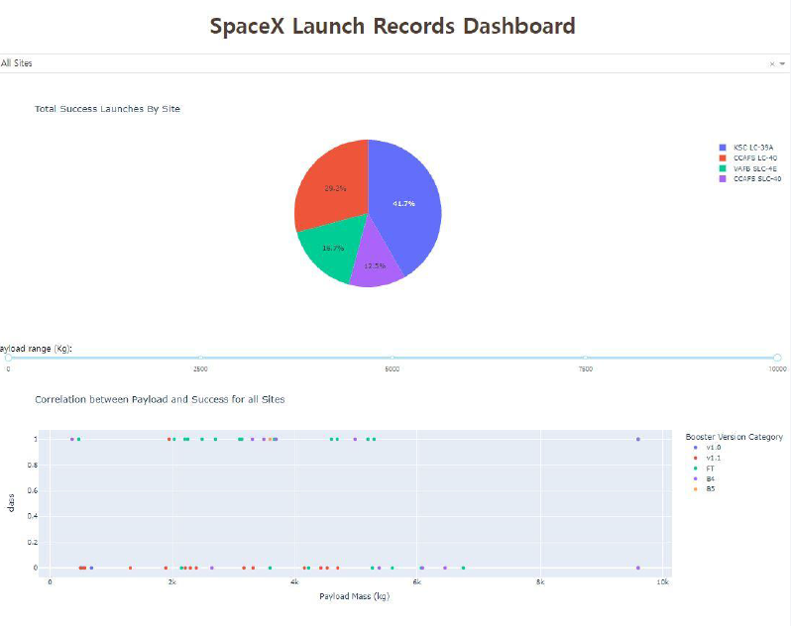
Results
Preview of Dashboard with Plotly Dash

Slide 18
Results
Preview of Dashboard with Plotly Dash
Accuracy of Models
%83
SVM
Classification Tree
Logistic Regression

Slide 19

Section 2

Slide 20
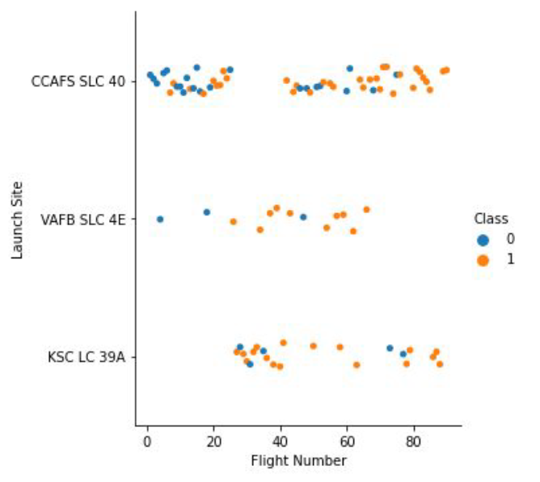
Flight Number vs. Launch Site
Class 0 → Failed launch
Class 1 → Successful launch
Success rate and flight number are positively related to each other
As the success rate has increased significantly since the 20th flight, this point seems to be a major breakthrough.

Slide 21
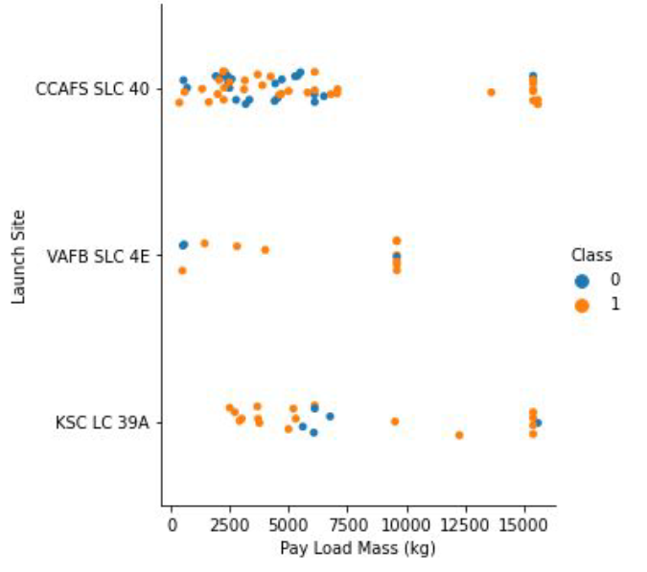
Payload vs. Launch Site
Class 0 → Failed launch
Class 1 → Successful launch
Although larger pay load mass means higher success rate, there is no clear pattern between the successful launch and pay load mass

Slide 22
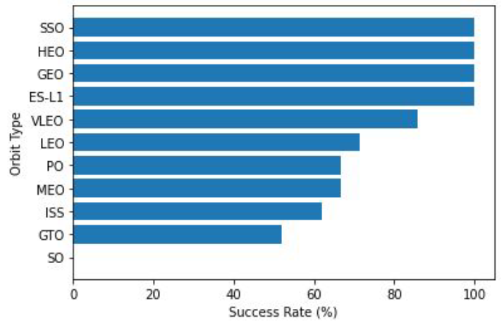
Success Rate vs. Orbit Type
SSO, HEO, GEO and ES-L1 type orbits have the best success rate which is 100%
GTO orbits success rate is the lowest one which is around 50%
SO orbit has no success rate for single attempt

Slide 23
Flight Number vs. Orbit Type
Class 0 → Failed launch
Class 1 → Successful launch
General pattern is that the launch outcome has a positive relationship with the flight number
However, for the GTO orbit, the situation is the opposite.
SpaceX starts from the LEO orbit with an average success rate and chooses the VLEO orbit with the highest success rate towards final flights.

Slide 24
Payload vs. Orbit Type
Class 0 → Failed launch
Class 1 → Successful launch
It is seen that the success rate increases as the payload mass increases in the LEO and ISS orbits.
However, it is difficult to predict whether the landing will be successful in the GTO orbit. There is no clear pattern.
SSO orbit looks perfect for the low pay load mass rate.

Slide 25
Launch Success Yearly Trend
Between 2010 and 2013, the trend is stable.
From 2013 to 2017, the general trend is in the direction of increase.
There is a decrease in the trend towards 2018.
In 2019, the highest success rate, approximately 90%, was reached.

Slide 26
All Launch Site Names
To the find the names of the unique launch sites, DISTINCT clause used in SQL query
SELECT DISTINCT LAUNCH_SITE FROM SPACEXTBL
CCAFS LC-40
VAFB SLC-4E
CCAFS SLC-40
KSC LC-39A
Here, ‘SPACEXTBL’ is the table name and LAUNCH_SITE is the column name in the table

Slide 27
Launch Site Names Begin with 'CCA'
To the find 5 records where launch sites begin with `CCA`, LIKE operator and LIMIT clause used in the SQL query
SELECT * FROM SPACEXTBL WHERE LAUNCH_SITE LIKE ‘CCA%’ LIMIT 5

Slide 28
Total Payload Mass
To the calculate the total payload carried by boosters from NASA, SUM() function used for the PAYLOAD_MASS_KG_ column and WHERE clause to filter boosters from CUSTOMER column.
SELECT SUM(PAYLOAD_MASS__KG_)
AS total_payload_mass_kg
FROM SPACEXTBL
WHERE CUSTOMER = 'NASA (CRS)'
45596

Slide 29
Average Payload Mass by F9 v1.1
AVG() function used to calculate the average value of column PAYLOAD_MASS__KG_.
To the filter dataset to perform calculations only if booster_version is F9 v1.1 WHERE clause is used.
SELECT AVG(PAYLOAD_MASS__KG_)
AS avg_payload_mass_kg
FROM SPACEXTBL
WHERE BOOSTER_VERSION = 'F9 v1.1'
2928

Slide 30
First Successful Ground Landing Date
MIN() function used to find out the earliest date in the column DATE.
To filter the dataset to perform a search only if landing_outcome is ‘Success’ WHERE clause is used.
SELECT MIN(DATE)
AS first_successful_landing_date
FROM SPACEXTBL
WHERE LANDING__OUTCOME
= 'Success (ground pad)'
2015-12-22

Slide 31
Successful Drone Ship Landing with Payload between 4000 and 6000
To filter the dataset to perform a search if landing__outcome is ‘Success (drone ship)’ WHERE clause is used with the AND operator is that display record which PAYLOAD_MASS__KG_ between 4000 and 6000.
SELECT BOOSTER_VERSION
FROM SPACEXTBL
WHERE LANDING__OUTCOME = 'Success (drone ship)'
AND (PAYLOAD_MASS__KG_ BETWEEN 4000 AND 6000)
F9 FT B1022
F9 FT B1031.2
F9 FT B1026
F9 FT B1021.2

Slide 32
Total Number of Successful and Failure Mission Outcomes
To calculate the total number of successful and failure mission outcomes COUNT() function used with GROUP BY statement which is groups rows that have the same values into summary rows to find the total number in each mission_outcome.
Nearly 99% missions are successfully completed.
SELECT MISSION_OUTCOME,
COUNT(*) AS total_number
FROM SPACEXTBL
GROUP BY MISSION_OUTCOME

Slide 33
Boosters Carried Maximum Payload
SELECT DISTINCT BOOSTER_VERSION,
PAYLOAD_MASS__KG_
FROM SPACEXTBL
WHERE PAYLOAD_MASS__KG_ = (
SELECT MAX(PAYLOAD_MASS__KG_)
FROM SPACEXTBL)
To list the names of the booster which have carried the maximum payload mass subquery is used.
Firstly using the MAX(), maximum value of payload mass calculated and after that to perform a search if PAYLOAD_MASS_KG__ is the maximum value of payload mass the dataset is filtered.
F9 B5 B10xx boosters could carried the maximum payload.

Slide 34
2015 Launch Records
To filter the dataset to perform a search if landing_outcome is ‘Failure (drone ship)’, WHERE clause is used with AND operator to display records in 2015.
SELECT LANDING__OUTCOME,
BOOSTER_VERSION,
LAUNCH_SITE
FROM SPACEXTBL
WHERE LANDING__OUTCOME
= 'Failure (drone ship)'
AND YEAR(DATE) = '2015'

Slide 35
Rank Landing Outcomes Between 2010-06-04 and 2017-03-20
WHERE clause filter the dataset to search if date is between 2010-06-04 and 2017-03-20.
Using ORDER BY method with DESC, sort the records in descending order.
Results shows the number of successes and failures between defined date was similar.
SELECT LANDING__OUTCOME,
COUNT(LANDING__OUTCOME) AS total_number
FROM SPACEXTBL
WHERE DATE BETWEEN '2010-06-04' AND '2017-03-20'
GROUP BY LANDING__OUTCOME
ORDER BY total_number DESC

Slide 36

Section 3

Slide 37
Locations of Launch Sites
Launch sites are located in United States.
Launch sites are near the coast.

Slide 38
Launch Outcomes with Color Label
Green color represents successful landing
Red color represents failed landing

Slide 39
Proximities of Launch Sites
Three questions are investigated:
Is it close proximity to railways? (For the transportation)
Is it close proximity to highways? (For the transportation)
Is it close proximity to coastline? (For the safety)
For the right map, all three questions have same answer which is Yes.
So, it is good choice for the launch sites.

Slide 40

Section 4

Slide 41
Success of Launches by All Sites
Although KSLC-39A is the most successful launch, CCAFS SLC-40 is the most unsuccessful launch among all sites.
The VAFB SLC-4E has the somewhat successful launch, possibly due to
This launch is located only California. Possibly, we can interpret from here west coast may be higher difficulty than east coast.

Slide 42
Launch Site with Highest Launch Success Ratio
Blue represents ‘Success’
Red represents ‘Failure’
Pie charts shows the success rate for KSLC-39A site.
Total landing number is 13.
10 of them are successful landings
3 of them are failed landings

Slide 43
Payload vs Launch Outcome
Let’s investigate the situation into the two part
For low weighted payloads ( 0 – 5000 kg )
For high weighted payloads ( 5000 kg – 10000 kg )
For the low part

Slide 44
Payload vs Launch Outcome
For the high part

Slide 45

Section 5

Slide 46
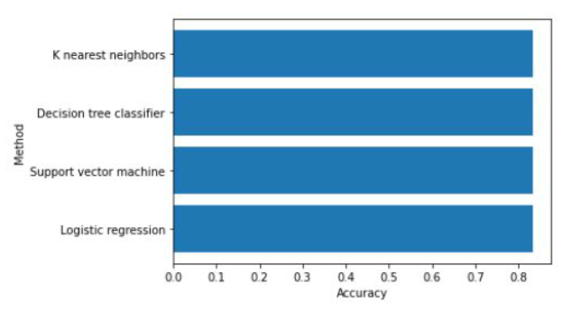
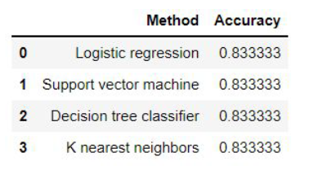
Classification Accuracy
For the test set all classification models have the same accuracy which is 83.3%
Therefore there is no best model for this data set
Because dataset are very small
To choice the best model, mora data is needed.

Slide 47
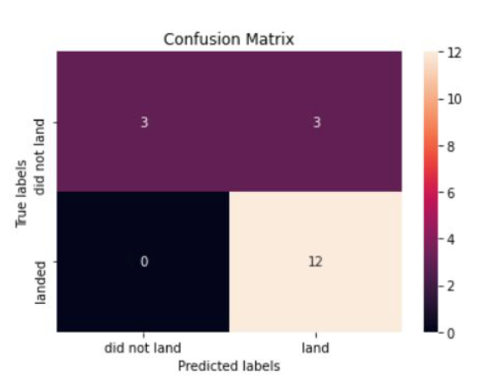
Confusion Matrix
Confusion matrix is same for all classification models because of the they have same accuracy rate.
The models predict;
12 successful landing when the true label was successful
3 failed landing when the true label was successful
3 successful landing when the true label was failure
Finally, the success rate is 15/18 which is 83.3%

Slide 48
Conclusions
1
It was determined that the success rate increased as the number of flights increased. In fact, this rate has exceeded 80% in 2019.
3
4
5
2
The orbital types with the maximum success rate are ES-L1, GEO, HEO and SSO.
The launch with the highest success rate among all sites is KSLC-39A.
The launch sites are close to highways, railways and coastline but far from cities due to the safety of city.
Low weighted payloads are higher success rate than high weighted payloads.
6
Defined dataset, all classification models are the same accuracy which is 83.3%

Slide 49
Appendix
Coursera Course URL

Slide 50


